Slide 1






BrainBox
Final Report
“Web Development Project”
(WDP301)
Developed by Lazy Code

Slide 2



Member
Le Minh Vuong
Nguyen Thi Thuy
Dinh Quoc Chuong
Ho Trong Nghia
Lam My Linh
Le Manh Hung

Slide 3
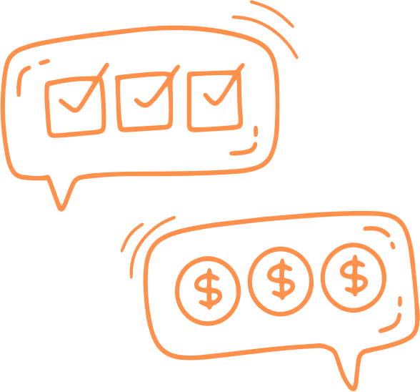


Content
1. Introduce & Goals
5. Development & Testing Process
2. System Architecture
6. Results & Evaluation
3. Requirements & Key Features
7. Future Development Direction
4. Technical Implementation & Technologies
8. Demo
9. Conclusion

Slide 4


Introduce and Goals
Introduce:
BrainBox is an advanced e-learning platform designed to connect learners, teachers, and administrators in a comprehensive, convenient, and secure system.
Goals:
Provide high-quality courses with personalized learning experiences.
Support teachers in course creation, student management, and revenue optimization.
Offer powerful management tools for administrators.

Slide 5
System Architecture
Client:
Web: Compatible with Chrome, Firefox, Safari.
Backend: Built with NestJS and PostgreSQL.
Frontend: Next.js integrated with Shadcn/UI.
External Integrations:
Payment: PayOS.
Communication: WebSocket.

Slide 6
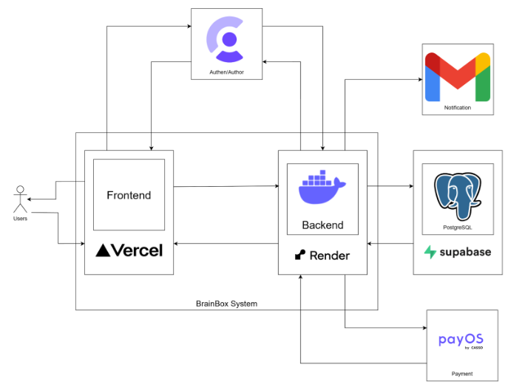
System Architecture

Slide 7


Requirements and Key Features
Authentication: Use Clerk with learners and teachers.
Search: Quick search for courses, teachers with filter with instant results
Learners: View list courses, Enroll course, View their enrolled courses, track progress, Change role to become a teacher, View their purchase history
Favorites Management: Save and organize favorite course.
Ratings: learners can rate courses.
Teachers: Create, Edit courses, View revenue reports for their courses, Manage their information, receive their revenue.
Chatting: user can send message with each others.
Admin: View analyze reports on users, courses, and payments, Approve or reject actions of the creating course and withdraw from teacher
AI-Powered Chat: Users can input a request, and the AI will return relevant results.

Slide 8
Technical Implementation & Technologies Used
Frontend:
Framework: Next.js with TypeScript for type safety.
UI: Shadcn/UI for modern designs.
Styling: Tailwind CSS for responsive and consistent layouts.
Backend:
Framework: NestJS for modular and scalable API development.
Database: PostgreSQL with Prisma ORM for schema definition and migrations.
Authentication: Clerk.
Third-Party Services:
Payment Gateways: PayOS.
Notifications: email notifications.
Hosting: Backend (Render), Frontend (Vercel)
Chatbot Agent: Chatbase
Development Tools:
Version Control: GitHub for repository management.
CI/CD: GitHub Actions for automated testing and deployment.

Slide 9

Development & Testing Process
Planning
Requirements Analys
UI/UX Design
Architecture Design
Deployment
Testing
Integration
Development

Slide 10
Related Documents
📝📅 Project Planning
🔍📑 Software Requirement Specification
🖥️🛠️ Software Design Specification
✅🔄 Tracking Task & Pull Request
🚀🎯 Final Release

Slide 11

📊 Results and Evaluation
✅ Complete core features:
Learners
View list courses
Enroll courses
Tracking their enrolled courses
Become a teacher
View their purchase history
View their account information
Teacher
CRUD their course
View revenue reports
View their account information
Receive their revenue
Admin
Manage user accounts
View, edit and analyze reports
Check course
AI chat
Chatting between users

Slide 12

📊 Results and Evaluation
Observable Core Features:
Successfully implemented the system’s core functionalities.
Stable performance under average load conditions.
User-friendly and intuitive interface.
Successfully integrated necessary technologies.
Security features function effectively to ensure data safety.
Positive Aspects:
Users appreciate the simple and easy-to-use interface.
Fast processing speed with minimal latency.
Core features work reliably and as expected.
Limitations & Suggested Improvements:
Enhancing personalization: Improve customization options for the user interface and experience.
Better performance with large datasets: Some features slow down when processing large volumes of data.
Adding more documentation: New users struggle with the initial learning curve.

Slide 13

🚀 Future Development Direction
Performance Optimization
Optimize algorithms to handle large datasets more efficiently.
Improve scalability to support a larger user base.
Security Enhancements
Strengthen data protection with advanced encryption.
Implement real-time security monitoring systems.
System Expansion
Support for more platforms (mobile app, web app).
Improve API for seamless third-party integration.
Enhancing User Experience
Develop AI-powered content personalization.
Add dark mode and flexible UI customization options.

Slide 14


🎬 Video Demo
🖥️ https://brainbox-platform.vercel.app

Slide 15
🎬 Conclusion
✅ Lessons Learned:
Deepened knowledge of scalable web development with modern frameworks.
Optimized API interactions for better performance.
Improved teamwork and project management for timely milestones.
✅ Summary of Achievements:
Developed and deployed the BrainBox platform with full key features.
Ensured smooth performance with positive user feedback.
Integrated real-time chat, AI recommendations, secure payments, and optimized caching.

Slide 16



Thank You

